Slide 1
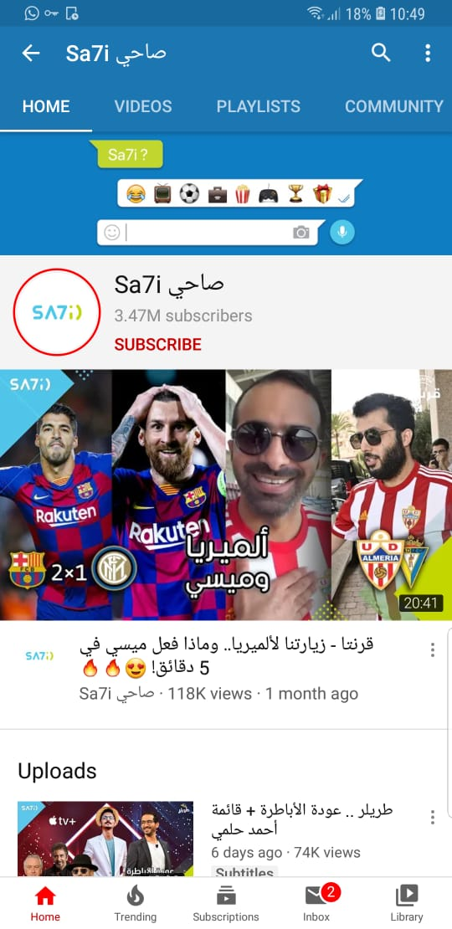





Sa7i Facts
76th
3.54M
Global Comedy Channel
Subscribers
1.8 M
787M
Followers
Views
451K
288K

Slide 2



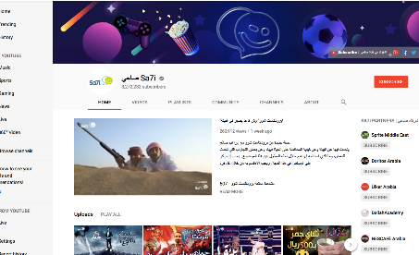
Sa7i Services
Integration
Creating a video sketch (up to 45 seconds) to deliver a specific brand message seamlessly integrated into Sa7i’s content.
Branded
Creating a standalone video dedicated to the brand’s message/activation using Sa7i’s dialect.
Social content production
If Sa7i is not your final destination, but video conceptualization and production is what you need. Sa7i presents an array of production services around the kingdom with capabilities of handling small to large scale projects.

Slide 3
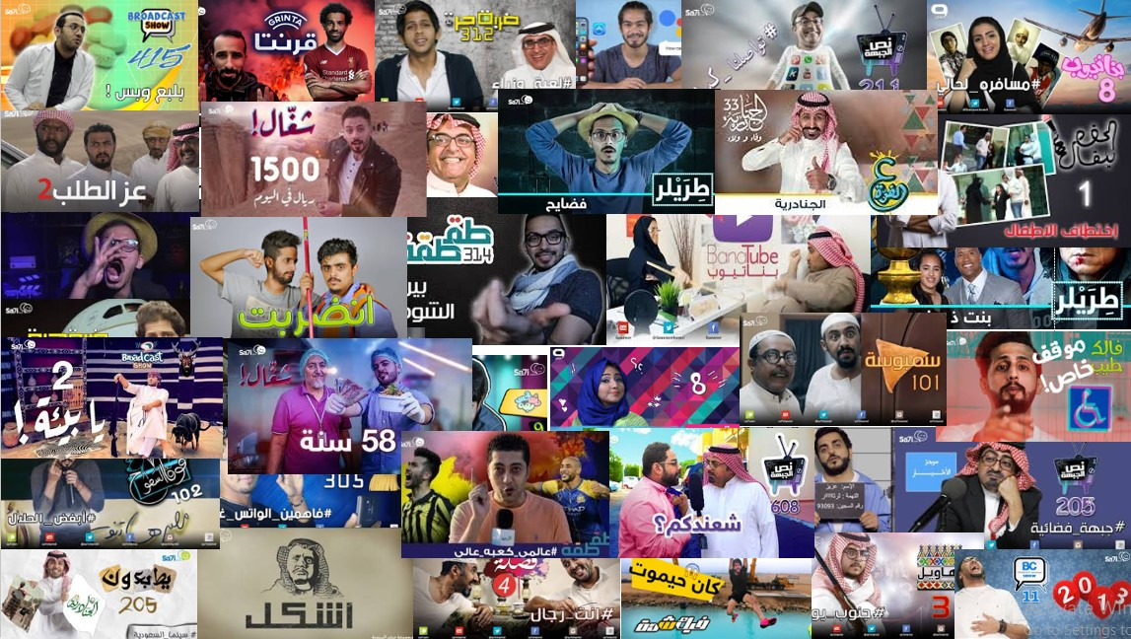
Sa7i Shows

Slide 4
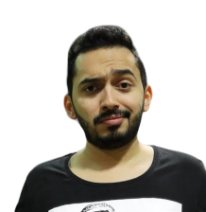





Tagtaga
w/ Bandar Halawani
After 6 fruitful seasons, Bandar Halawani continues to cover the vibe of the Saudi League games from inside the stadiums in his leading show Tagtaga. Winning or losing, your team will have its share of sarcasm on Tagtaga.
% of Views in KSA | Completion Rate | Avg. Retention Rate
89% | 58% | 4:47
@BKH_9
81.8K followers
@BKH_9
66.1K followers
2-3 Episodes / month
Benefits | Gross Rate
Product integration (up to 45 sec.) | USD 25,000
Host Social Media Reach (143K)
Sa7i Social Media Reach (5.4M)
Avg. Views in 30 days: 500K
MALE
Gender
FEMALE
82%
18%
[13-34]
Age
Over 34
85%
15%

Slide 5


Grinta
w/ Abdul Rahman Aseeri
A football show covering the European football scene focusing on the stadiums hosting the UEFA Champion’s League games. Grinta is there to capture the fans’ vibe around every match.
% of Views in KSA | Completion Rate | Avg. Retention Rate
75% | 54% | 4:48
@abdulrahman_188
51.2K followers
@dhmenteni
3.3K followers
As per UEFA schedule
Benefits | Gross Rate
Product integration (up to 45 sec.) | USD 30,000
Host Social Media Reach (37.8K)
Sa7i Social Media Reach (5.4M)
Avg. Views in 30 days: 350K
MALE
Gender
FEMALE
26%
74%
[13-34]
Age
Over 34
40%
60%

Slide 6
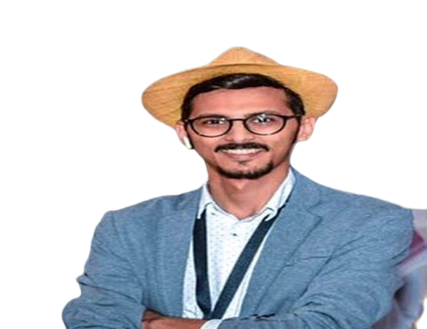

Trayler
w/ Mohammed Shehri
Upon the return of the cinema to KSA, Sa7i presents the first and only show dedicated to the Saudi movie & film fanatics. Mohammad Al Shehri has it all. Latest releases, premieres and awards are all on Trayler.
% of Views in KSA | Completion Rate | Avg. Retention Rate
76% | 53% | 5:05
@m77_alshehri
63.4K followers
@m77_alshehri
87.9K followers
Fortnightly
Benefits | Gross Rate
Product integration (up to 45 sec.) | USD 20,000
Host Social Media Reach (62K)
Sa7i Social Media Reach (5.4M)
Avg. Views in 30 days: 250K
MALE
Gender
FEMALE
80%
20%
v
[13-34]
Age
Over 34
87%
13%
v

Slide 7


Shaghal
w/ Mohammed Bafakih
A show directed to young Saudis helping them in developing their entrepreneurship skills in setting up small business initiatives by showcasing how things can be done through an exciting journey at work place.
% of Views in KSA | Completion Rate | Avg. Retention Rate
76% | 59% | 4:03
@mohammedbafaqeh
3.6K followers
Monthly
Benefits | Gross Rate
Product integration (up to 45 sec.) | USD 15,000
Host Social Media Reach (3.5K)
Sa7i Social Media Reach (5.4M)
Avg. Views in 30 days: 250K
MALE
Gender
FEMALE
94%
6%
v
[13-34]
Age
Over 34
86%
14%
v

Slide 8


Honna
w/ Ilham Alawi
A woman empowerment show to enhance their career opportunities skills and to direct them towards new businesses that women did not experience yet.
% of Views in KSA | Completion Rate | Avg. Retention Rate
80% | 60% | 5:37
@ellie.sherry
60K followers
@ellie.sherry
10.5K followers
Monthly
Benefits | Gross Rate
Product integration (up to 45 sec.) | USD 20,000
Host Social Media Reach (60K)
Sa7i Social Media Reach (5.4M)
Avg. Views in 30 days: 250K
MALE
Gender
FEMALE
26%
74%
[13-34]
Age
Over 34
40%
60%

Slide 9

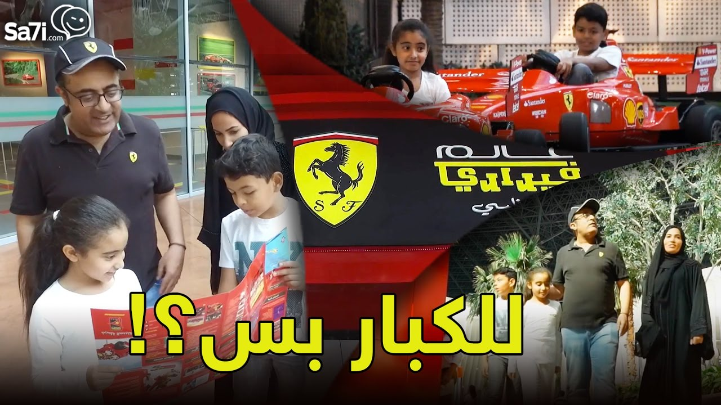

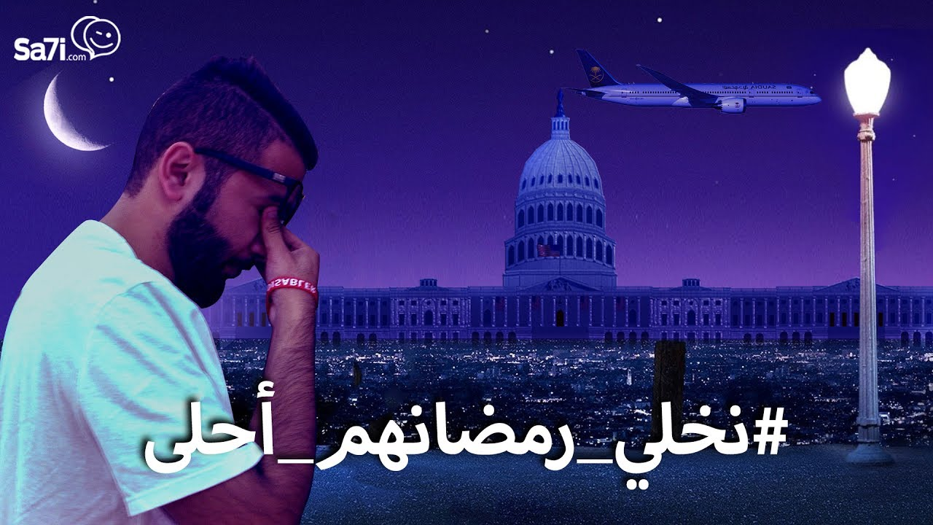
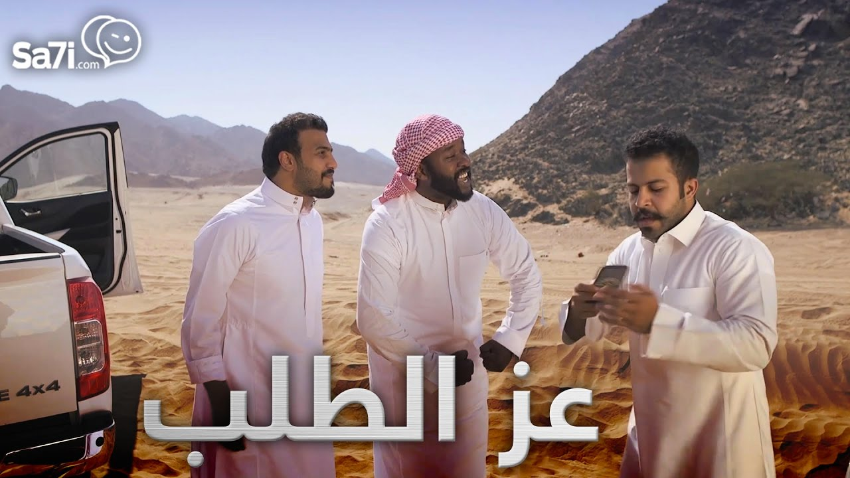








Standalone Branded Content
This is a tailor-made video which is conceptualized and scripted upon brief with the proper formula between content & host to push that brief to a specific target audience.
Benefits | Net Rate
Branded video (up to 5 min.) | US$ 5,000
Sa7i Social Media Reach (5.4M)

