Slide 1

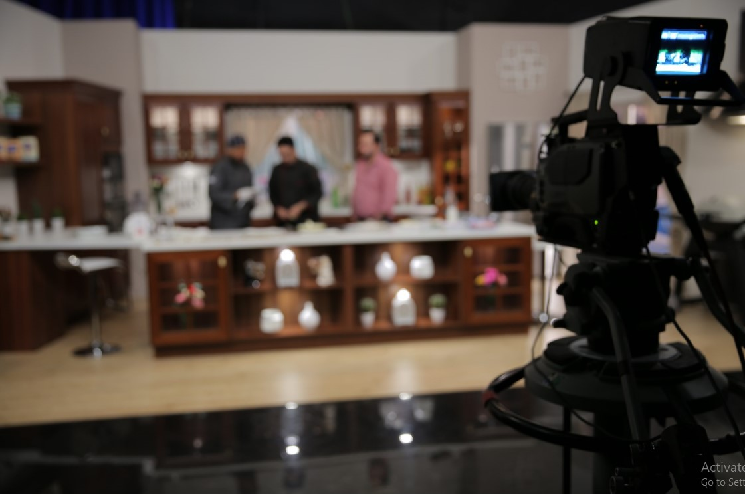
Matbakhouki
Presentation
First Arab
Media
Services
Ramadan top cooking show
Streamed on Iqraa (top 10 most watched channel during Ramadan)
Running for more than 15 years
2020

Slide 2
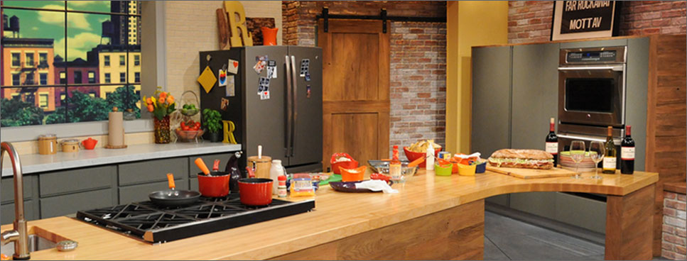

Matbakhouki Synopsis
A cooking program that focus to give knowledge about top cuisines of different countries around the world. The show will take place in a studio set where the celebrity chef prepares one major dish over the course of an episode taking the viewing audience through the food’s inspiration, preparation and stages of cooking.
Our Chef for our upcoming season has 13 years experience of cooking local and international cuisines and owns a private restaurant called “chef steakhouse”.
The show has been following a success since its beginning, (15 years ago) due to the creativity of the cooking process using special ingredients to create modern main and side dishes, entries and desserts.

Slide 3
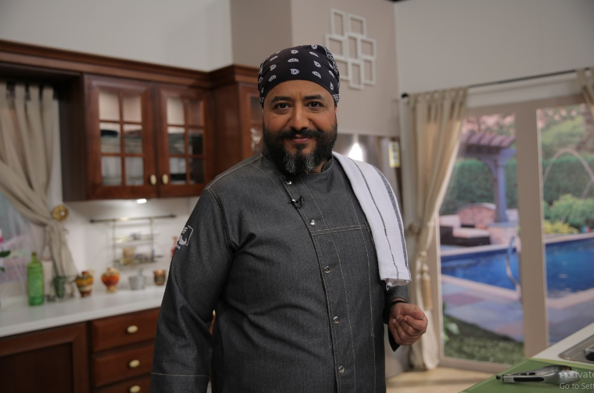

About Our chef.
Adnan Yamani – Participant in Top chef’s (final 10) program
“I started to love cooking when I was 8 years old. A professional chef is an artist that starts from the end. He has to imagine how his dish will look like before he has even started….like an engineer that knows the shape of the building before finishing it.”
Adnan’s social media statistics
50.5K
2.25K
2.8K

Slide 4
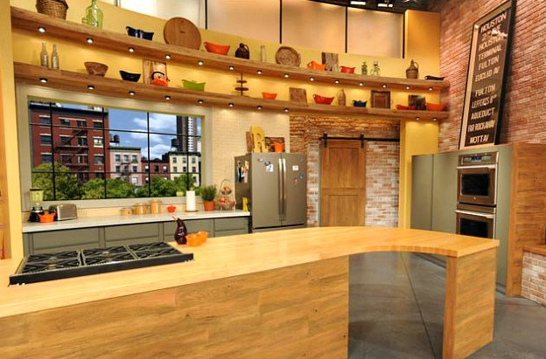
The preferred cooking
show in Ramadan
For 15 consecutive years, Matbakhouki has been the number one cooking show in Ramadan among all channels.
Competing with highly viewed TV Stations, The chef manages to grab the attention of the viewers in his presenting style and unprecedented recipes.
In the following slides, you can check all detailed statistics verified from Ipsos.

Slide 5
Statistics on Iqraa & Matbakhouki
Analyzed by Ipsos

Slide 6
Top Islamic Channels during Ramadan since 2015
2015 – 1st Iqraa (7.37)
2016 – 1st Iqraa (8.37)
2017 – 1st Iqraa (10.0)
2018 – 1st Iqraa (9.5)
2019 – 1st Iqraa (8.3)
2020 – 1st Iqraa (8.6)

Slide 7
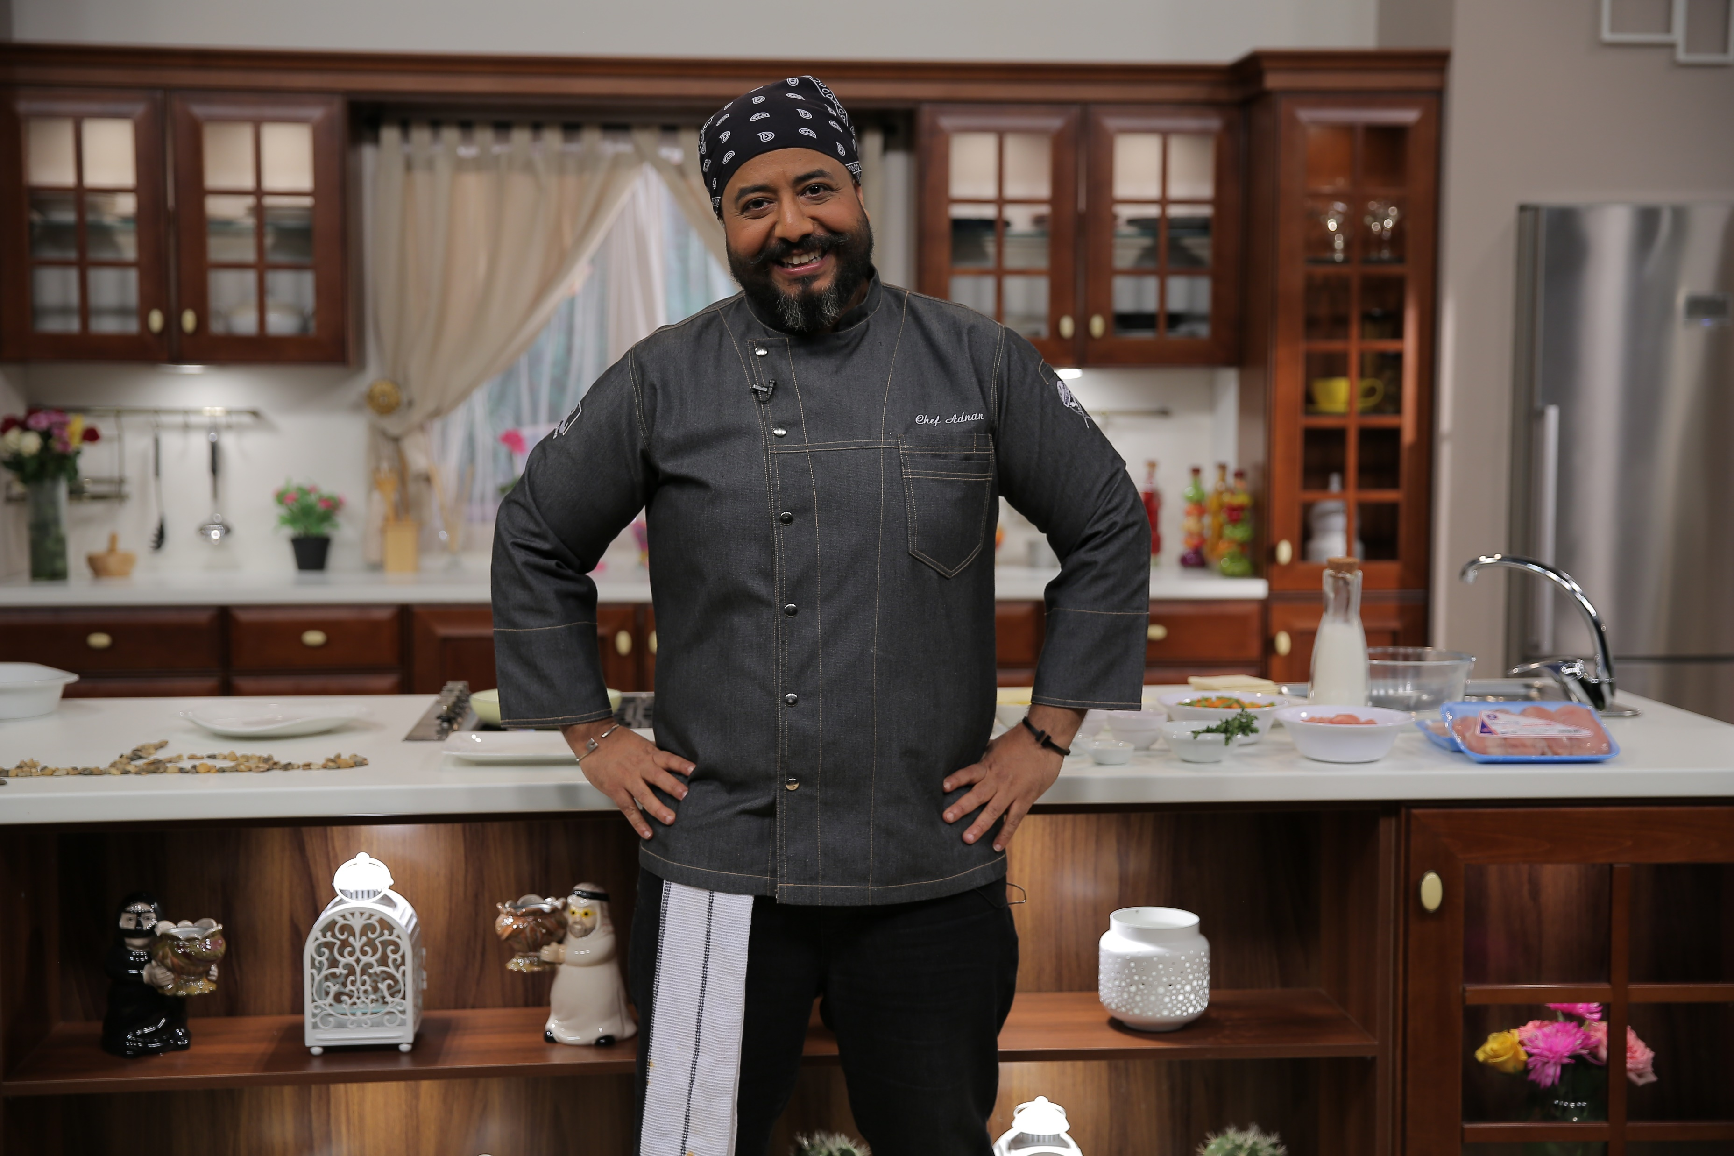
Matbakhouki – Ramadan
Package
Ramadan Package – 30 Episodes:
Episode Duration: 30 Minutes (Daily)
Broadcast Time:TBA
1 Repeat: TBC
Sponsorship detailed Benefits:
Product placement inside the Kitchen during all episodes.
The Chef will use the Sponsor’s products during the cooking process.
The Sponsor’s Logo will appear on the program’s promotions and advertisements.
The sponsor’s representatives are most welcome for any visits.
Sponsorship TV Benefits:
Promotional Announcements with VO and Logo 300 x 5”
Open / Close credits 60 x 5”
2Adjacent spots before & after the Episode 60 x 30”
2 Participation spots during the Episode 60 x 30”
Same benefits for the repeat
Product placement and product usage
Ramadan Sponsorship Cost (30 eps)
US$ 350,000
Product Placement & Branding (30 eps)
US$ 200,000
Sponsorship by episode
Contact a sales person

Slide 8
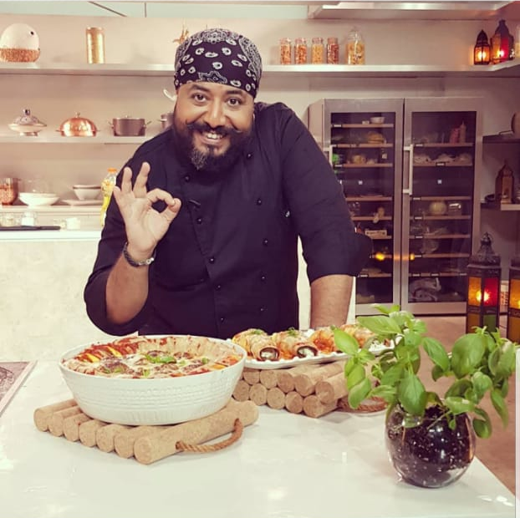
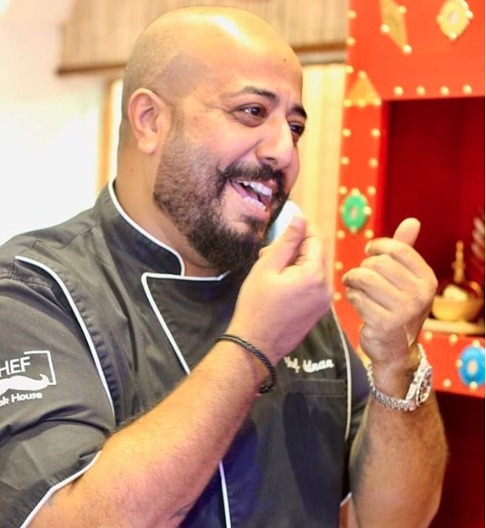
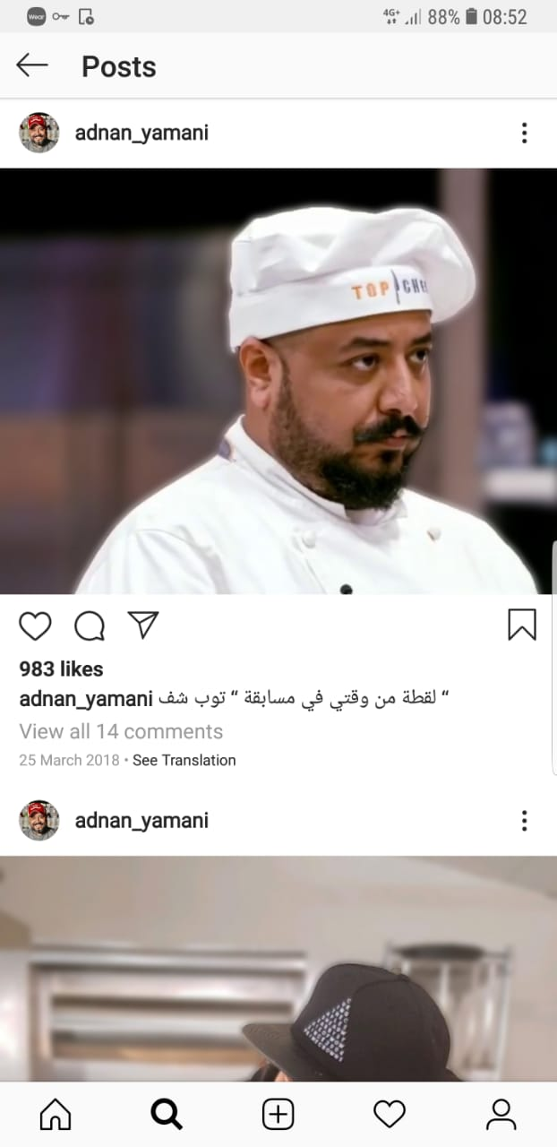
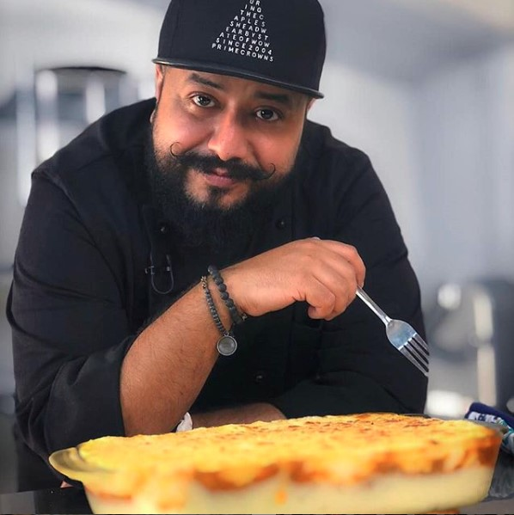
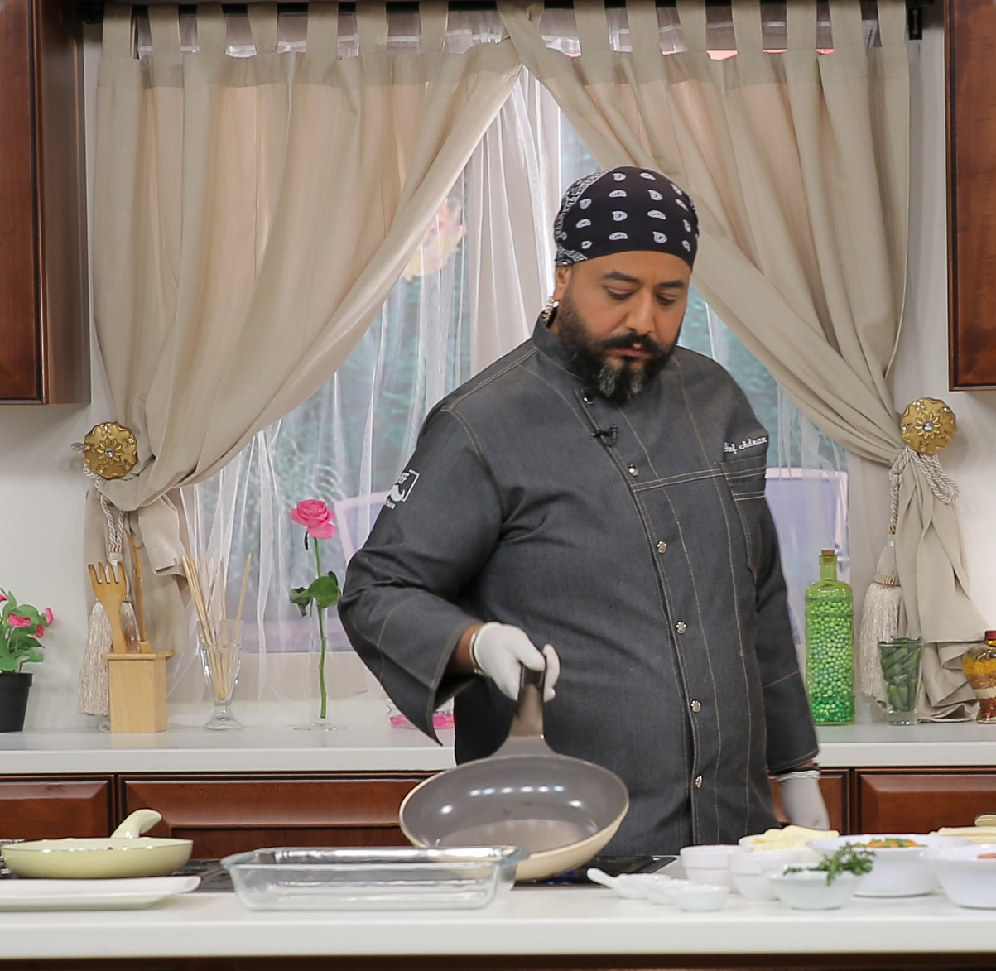
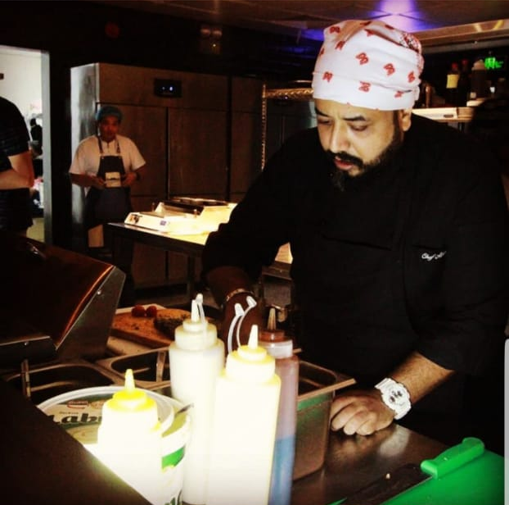

Slide 9












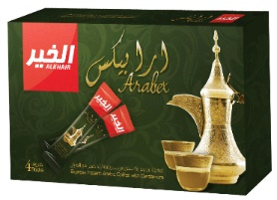









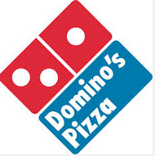











































Our valued clients

Slide 10

Contact Info
Jeddah, KSA: Sales & Marketing Department
Tel. +966 12 6658333
E-mail: info@fams-me.com
Dubai, UAE
E-mail: info@fams-me.com
+966580813214
+966504660663
www.fams-me.com

